Slide 1
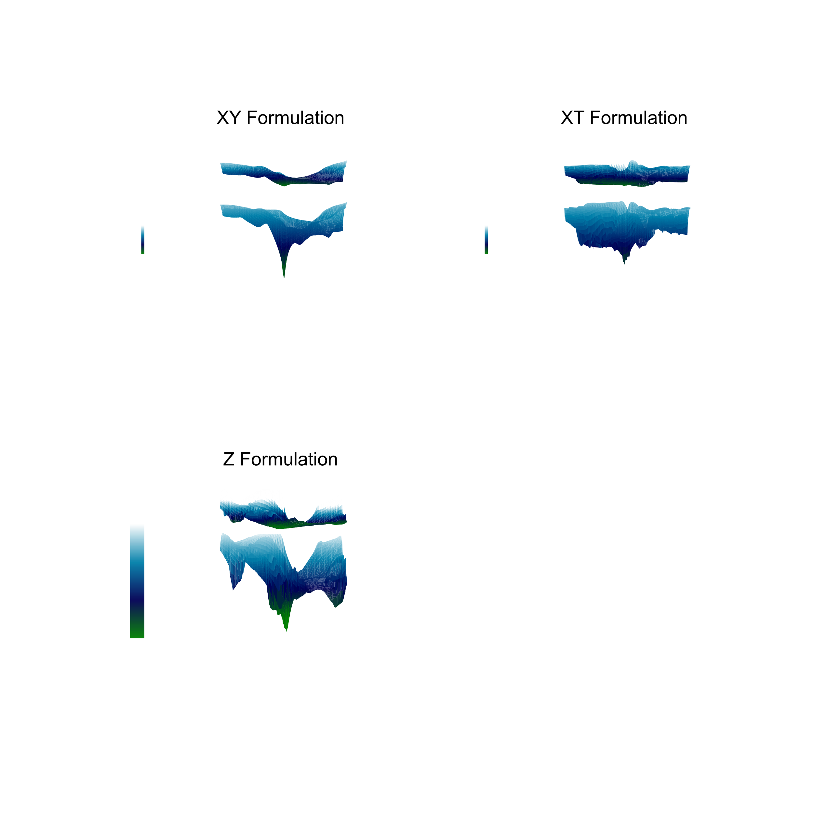


Scientific Machine Learning (SciML) for Solving PDEs
(Case Studies: two-phase flow in porous media)
University of Stavanger (Jan. 2025)

Slide 2

JASSEM ABBASI
https://jcabbasi.github.io/
Scientific Machine Learning & Reservoir Engineering
CURRENT ACTIVITY
Application of Physics-informed Machine Learning for Modelling of Multiphase Flow Processes in Porous Media
EXPERIENCE
PUBLICATIONS(selected)
ABOUT ME
ETH Zürich (2024)
ETH AI Center – Visiting Researcher
EQUINOR ASA, Norway (2022) [intern]
Subsurface Geoscience/Reservoir Simulation Engineer
ZODAN SOLUTIONS LTD., UK (2019-2020)
Scientific Software Developer
SHIRAZ UNIVERSITY/PETROAZMA COMPANY (2016-2018)
Reservoir [Simulation] Engineer/Researcher
PETROTIRAZIS OIL COMPANY PTED. (2016) [intern]
Scientific Software Developer (Intern)
ML4PS @ NeurIPS (2024): History-Matching of Imbibition Flow in Multiscale Fractured Porous Media Using Physics-Informed Neural Networks (PINNs)
SPE Journal (2024): Application of Physics-Informed Neural Networks for Estimation of Saturation Functions from Counter current Spontaneous Imbibition Tests →
Neurocomputing (2024): Physical Activation Functions (PAFs): An Approach for More Efficient Induction of Physics into Physics-Informed Neural Networks (PINNs) →
Energy and Fuels (2023): Simulation and Prediction of Spontaneous Imbibition at Early and Late Times Using Physics-Informed Neural Networks →
…
Dedicated Research Scientist specializing in computational modeling and data analysis with over five years of experience in both academic and industry research. Expertise in Scientific Machine Learning, numerical simulations, and fluid dynamics, with a focus on subsurface flow.
QUALIFICATIONS
Programming
Scientific Software Development
Machine Learning | Deep Learning
Optimization | Inverse Calculations
Applied Mathematics | Statistics
Data Science | Data Analytics
Reservoir Engineering/Simulation
Computational Fluid Dynamics (CFD)
Flow in Porous Media
Thermodynamics
EDUCATION
UNIVERSITY OF STAVANGER (2021- Dec. 2024)
Scientific Machine Learning (PhD)
SHIRAZ UNIVERSITY (2014-2016)
Reservoir Engineering (M.Sc.)
PETROLEUM UNIVERSITY OF TECHNOLOGY (2010-2014)
Reservoir Engineering (B.Sc.)

Slide 3
Contents
Day 1
Part 1: Scientific Machine Learning (SciML): Introduction and Recent Advances
Part 2: Physics-Informed Neural Networks (PINNs)
Day 2
Part 3: A Case Study: Inverse Calculations on Spontaneous Imbibition Experiments
Part 4: Hands-on Experience with PINNs and Neural Operators
University of Campinas (Nov. 2024)

Slide 4
Key Take-aways
Understand what SciML is?
Recognize the limitations of traditional numerical methods for PDEs, and why SciML can help.
Identify the unique advantages SciML offers in handling complex PDE challenges.
Limitations and future directions of SciML in PDEs
See real-world examples where SciML improved PDE-solving outcomes

Slide 5
References
AI in the Sciences and Engineering (2024), ETH Zurich, CAMLab
https://camlab.ethz.ch/teaching/ai-in-the-sciences-and-engineering-2024.html
Deep Learning for Scientists and Engineers, by George Em Karniadakis, Khemraj Shukla, Summer 2023 at KTH Stockholm
Steve Brunton YouTube channel. https://www.youtube.com/@Eigensteve
https://sciml.tamids.tamu.edu/ecen-689-scientific-machine-learning-spring-2024/
…

Slide 6

What is Scientific Machine Learning (SciML)?
Scientific Machine Learning (SciML) is an interdisciplinary field that combines principles of scientific computing, applied mathematics, data science, and machine learning to model, predict, and analyze complex systems governed by the laws of physics, chemistry, biology, or engineering.
Main Characteristics: Use Domain Knowledge
Notes:
The primary goal of SciML is to integrate machine learning techniques with scientific models to improve the understanding, simulation, and optimization of physical systems.

Slide 7
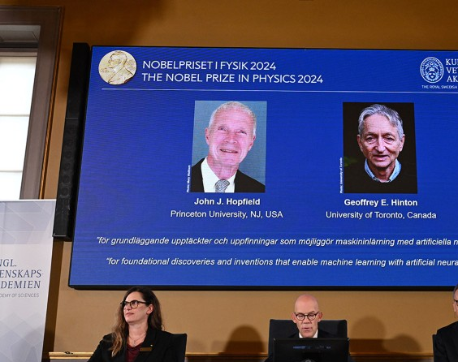
The Nobel Prize in Physics & Chemistry
#AI4Science
Trained neural networks using physics:
John Hopfield (Princeton University)
Geoffrey Hinton (University of Toronto)
For computational protein design
David Baker (University of Washington)
Demis Hassabis (Google DeepMind)
John M. Jumper (Google DeepMind)

Slide 8
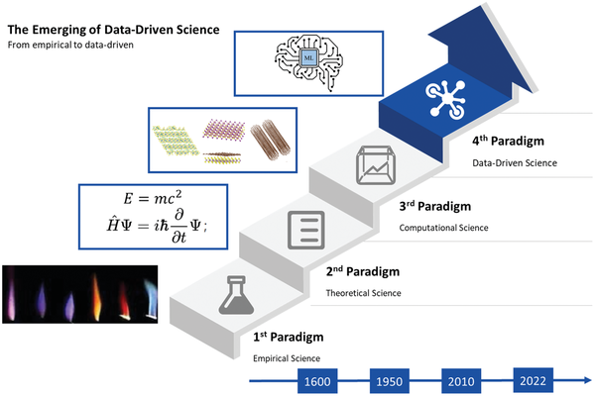
Paradigms of Science What is happening?
Data-Driven Materials Innovation and Applications, 2022

Slide 9
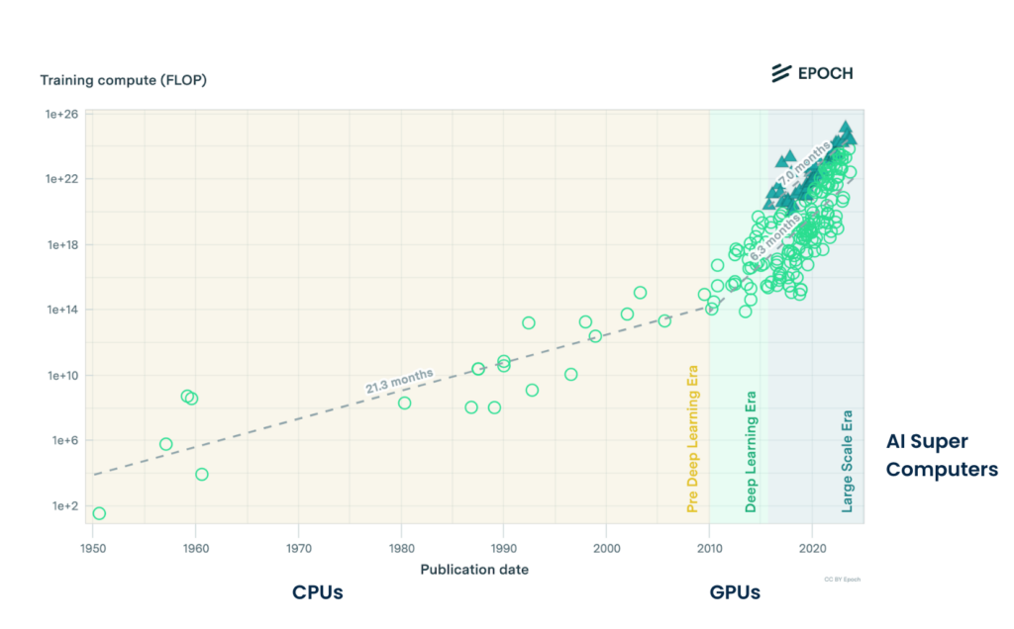
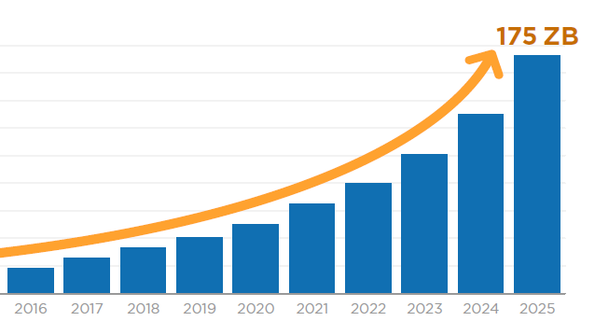
Why now?
Volume of Data Generated Annually
Training Compute
Larger Datasets
Better Hardware
Smarter Algorithms

Slide 10
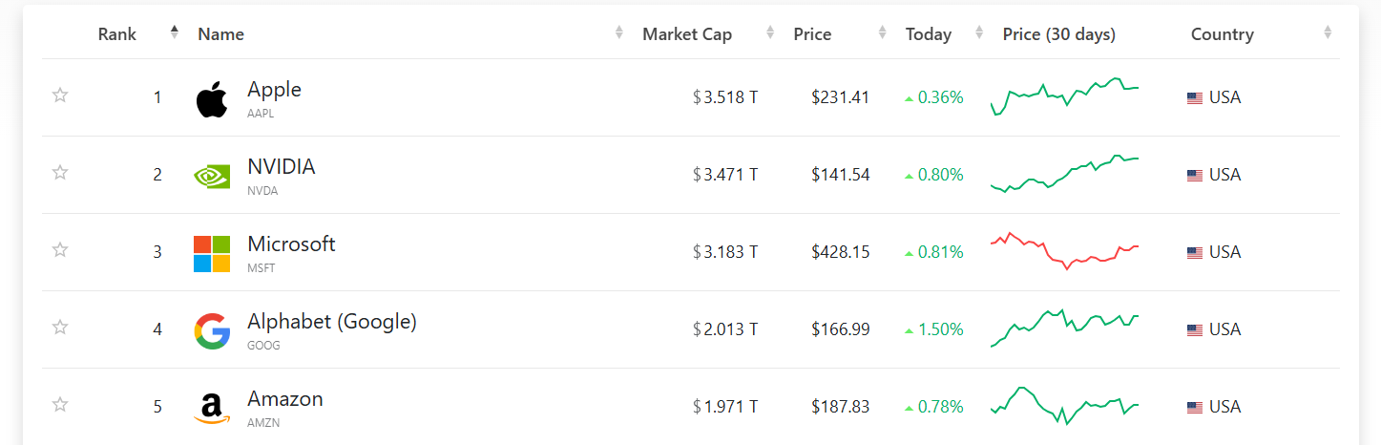
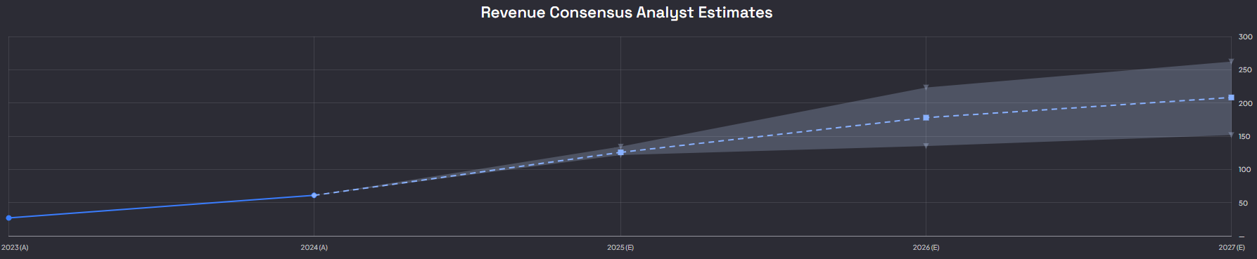
NVIDIA, a new giant!

Slide 11
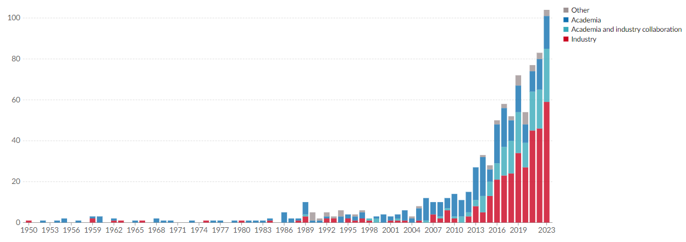
Affiliation of teams building notable AI systems Growing …
AI-assisted researchers: **
discover 44% more materials,
39% increase in patent filings,
17% rise in downstream product innovation.
** Artificial Intelligence, Scientific Discovery, and Product Innovation, Aidan Toner-Rodgers, 2024

Slide 12
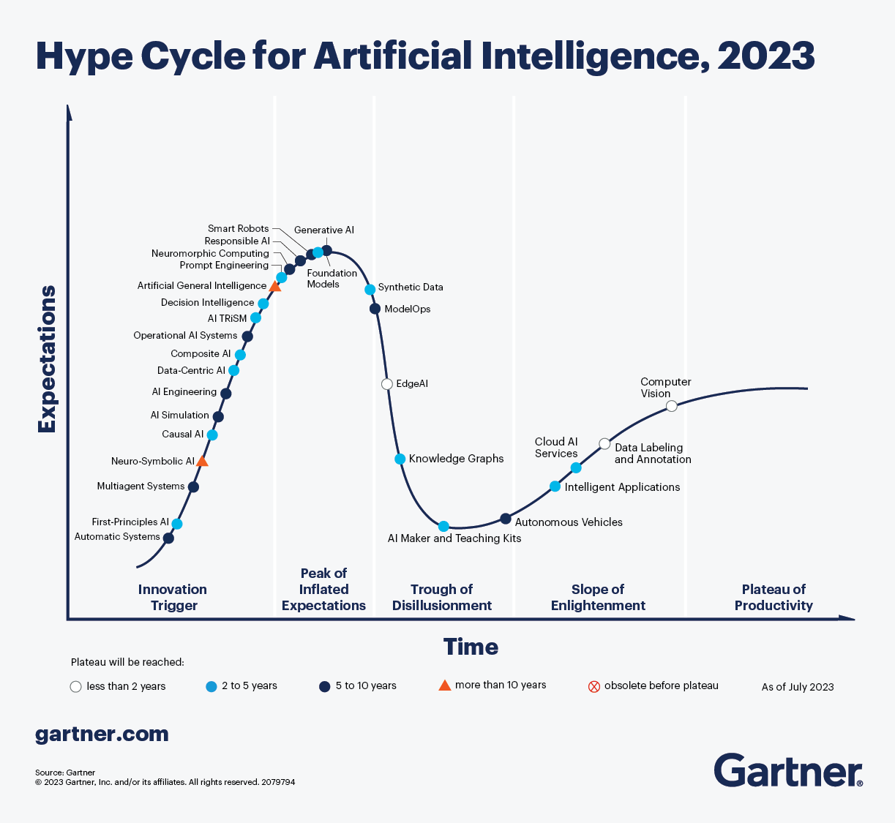
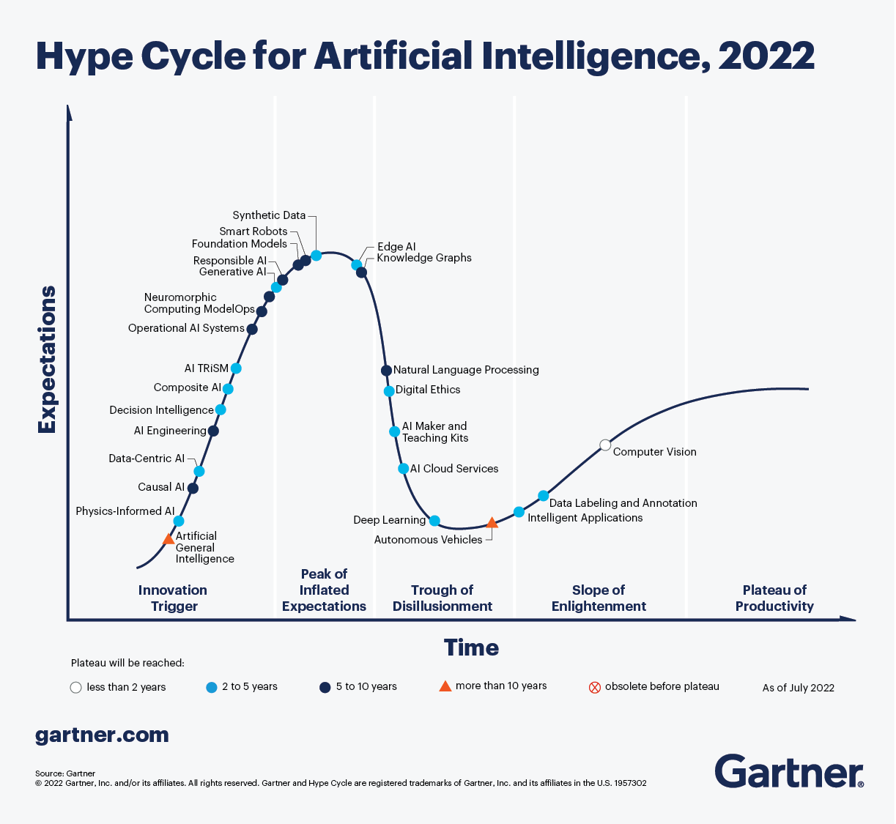
Artificial Intelligence Hype Cycle (2023)
Just
Beginning
of an Era!
AI Simulation
Physics-informed AI

Slide 13
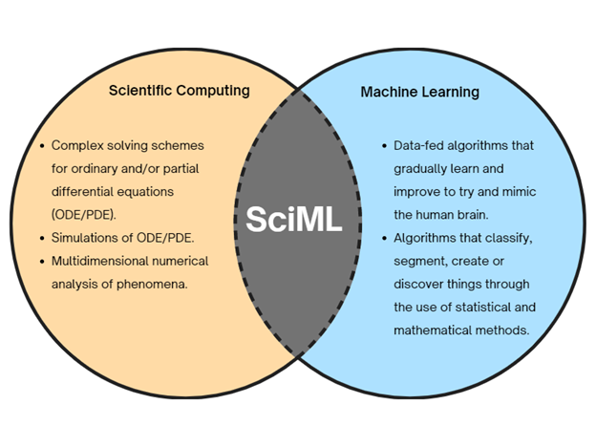
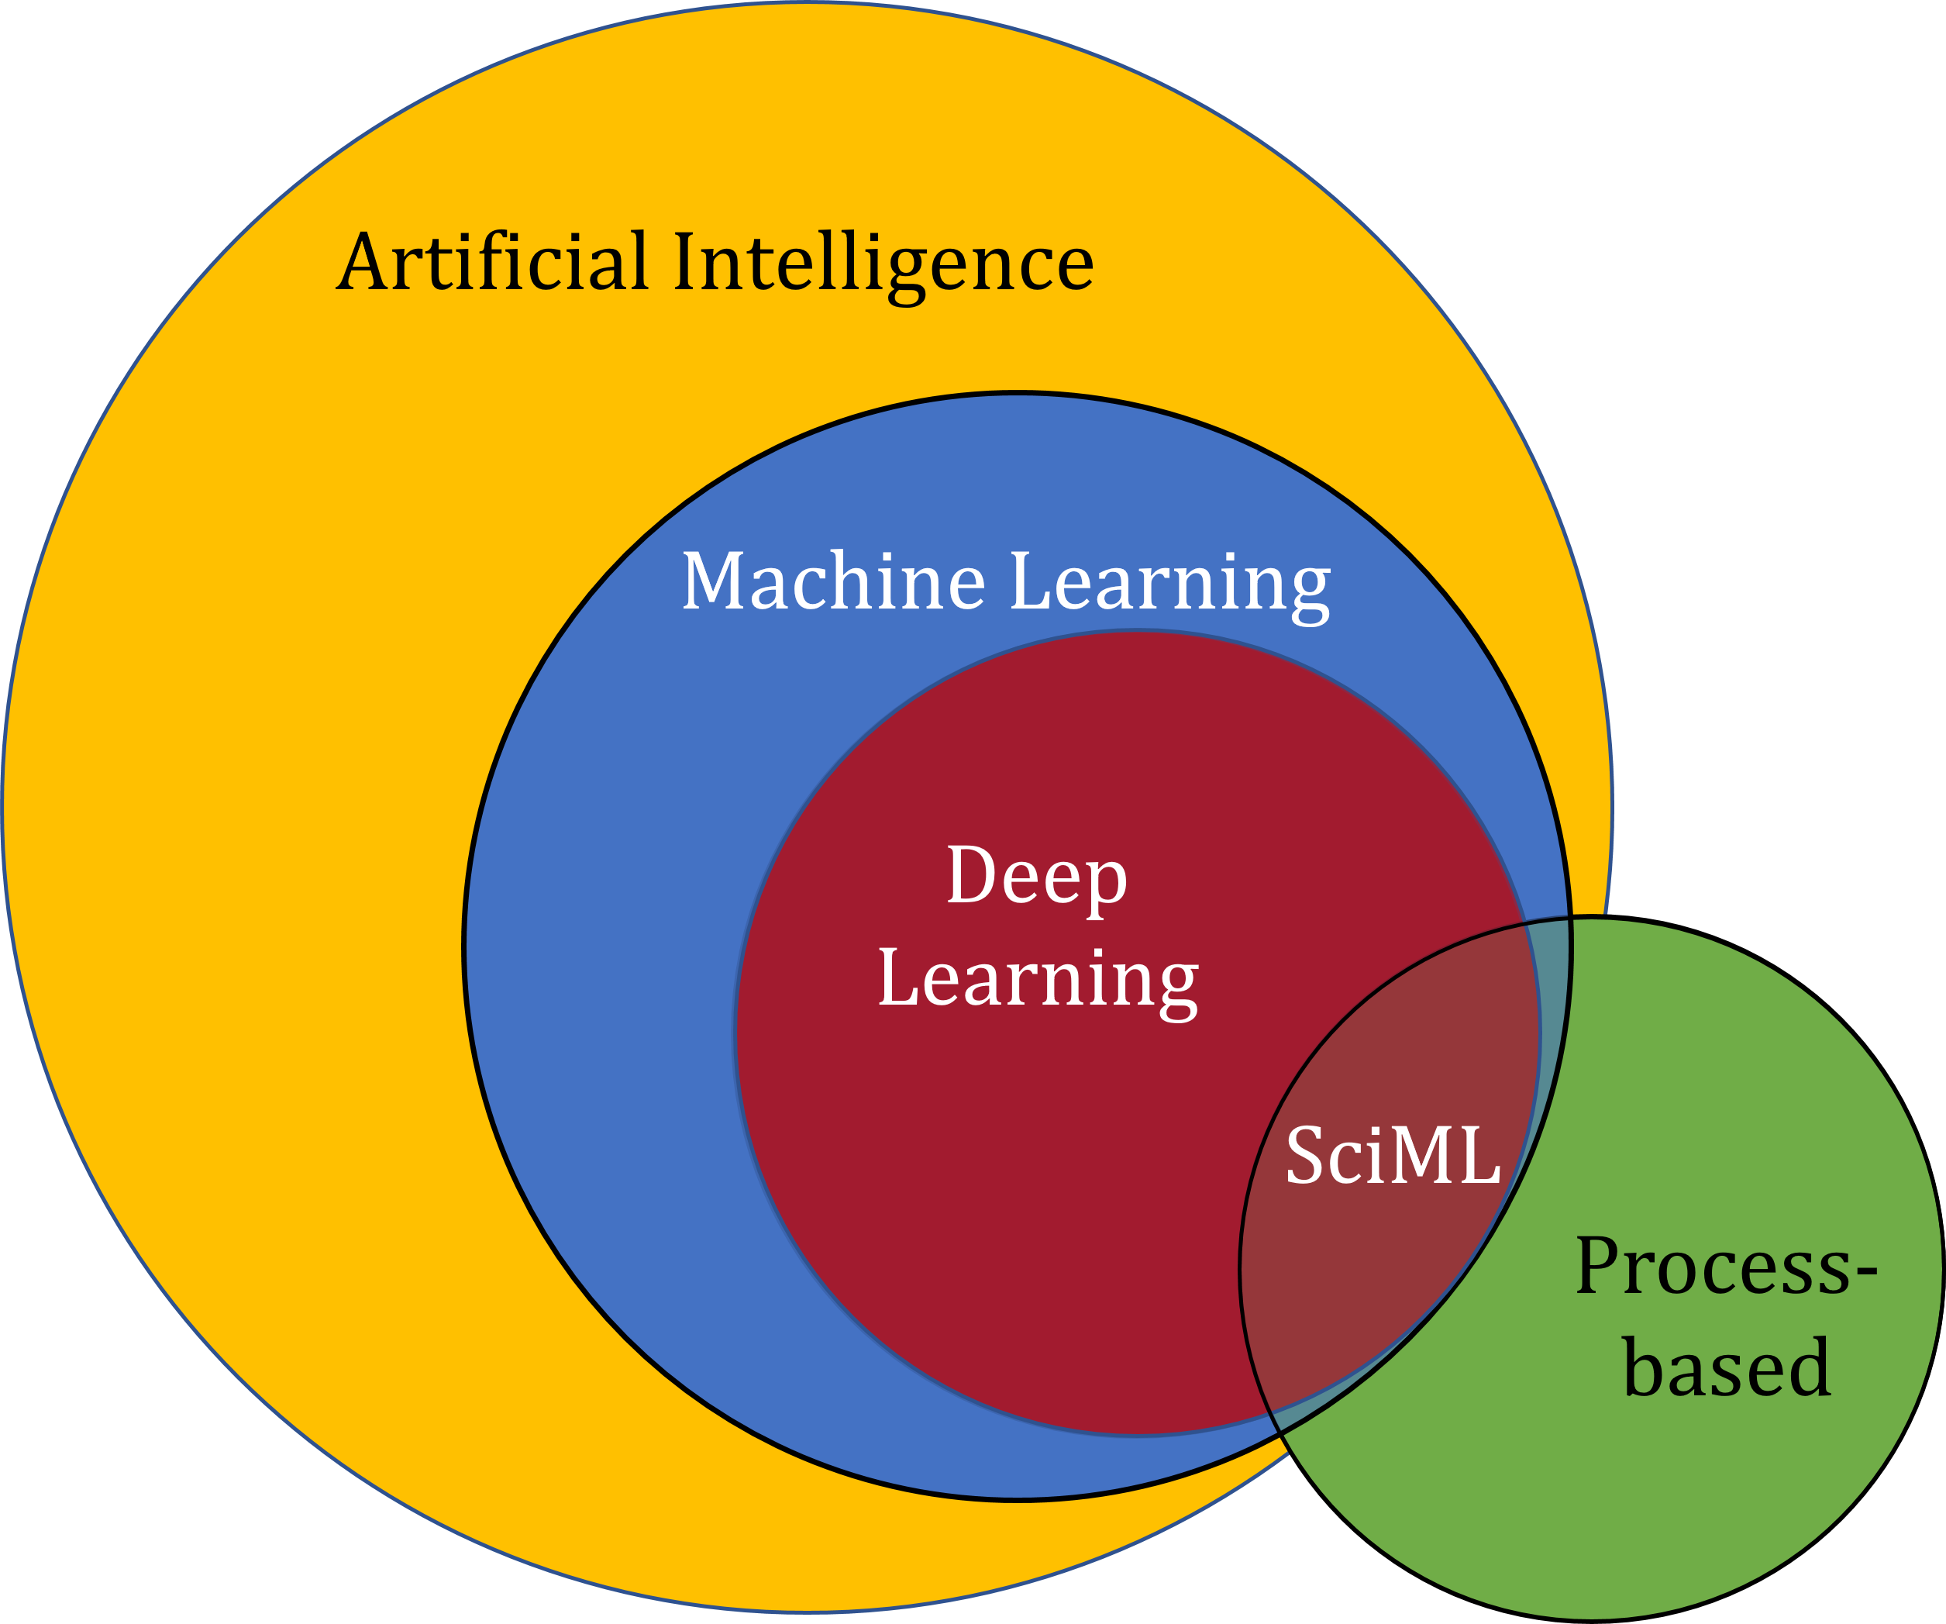
Scientific Computing & Machine Learning for PDEs
Notes:
https://sciml.wur.nl/reviews/sciml/sciml.html

Slide 14

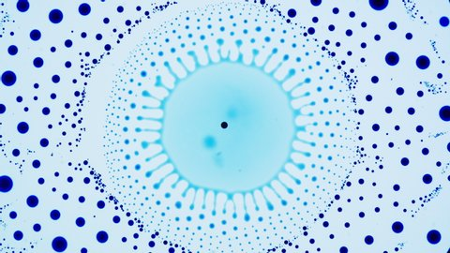
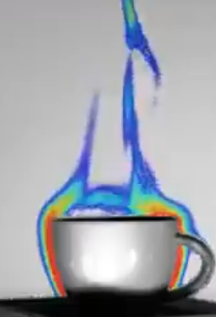
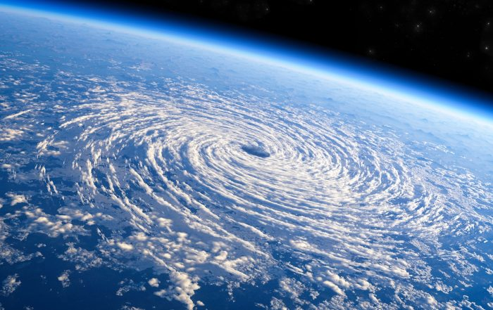
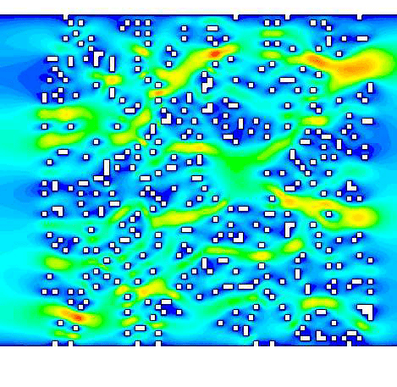
Partial Differential Equations (PDEs) They are everywhere!
Black-holes
Surface Phenomena
Navier-Stokes Equations
Flow in Porous Media
Cup of Espresso!
Notes:
Partial diferential equations (PDEs) are among the most universal and parsimonious descriptions of natural physical laws, capturing a rich variety of phenomenology and multiscale physics in a compact and symbolic representation.

Slide 15
Partial Differential Equations (PDEs) They are everywhere!
Classification of Second-Order PDEs:
1) Elliptic PDEs (e.g., Laplace’s equation):
Steady-state problems, no time dependency.
2) Parabolic PDEs (e.g., Heat equation):
Time-dependent problems with diffusion-like behavior.
3) Hyperbolic PDEs (e.g., Wave equation):
Time-dependent problems with wave-like behavior.
Notes:
Partial diferential equations (PDEs) are among the most universal and parsimonious descriptions of natural physical laws, capturing a rich variety of phenomenology and multiscale physics in a compact and symbolic representation.

Slide 16
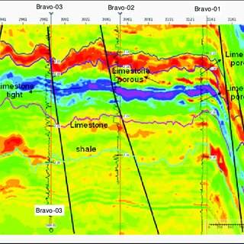
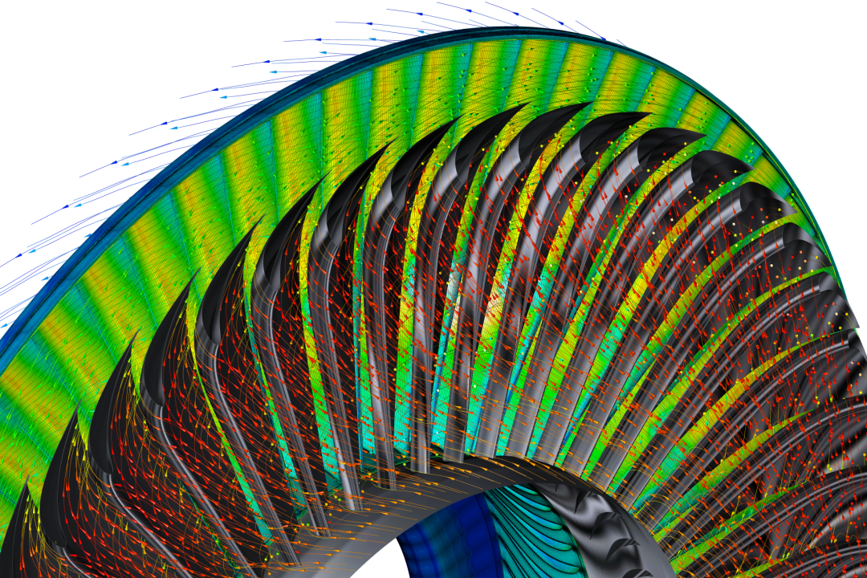
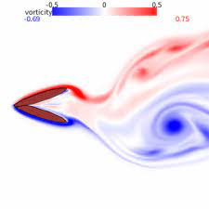
Key Scientific Tasks
Forward Simulation
Inverse Simulation
Equation Discovery
y = f(x)
y = f(x)
y = f(x)

Slide 17
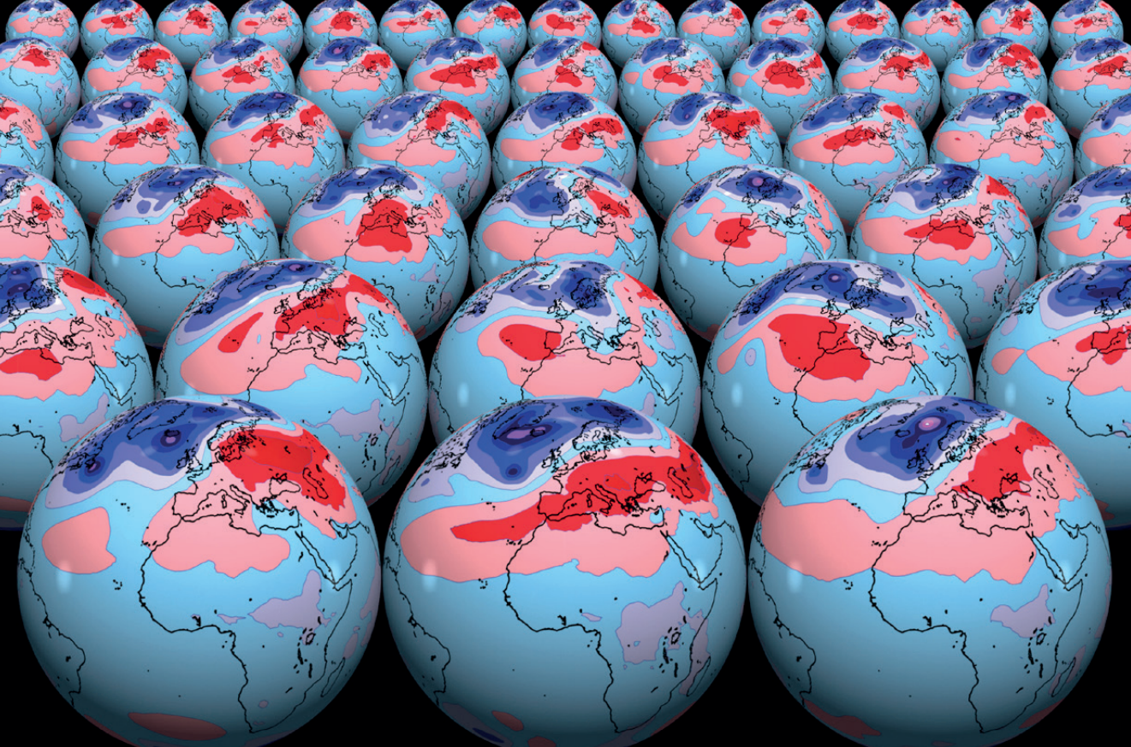
Why a revolution is needed?
Numerical Methods are very Successful
(issues: high resolution, multiphysics, multiscale)
Challenging Tasks:
Optimal Design
Inverse Problem
Uncertainty quantification (UQ)

Slide 18

Scientific Machine Learning Incorporating Physics into Learning

Slide 19
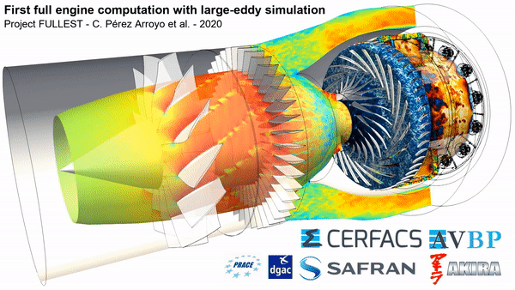
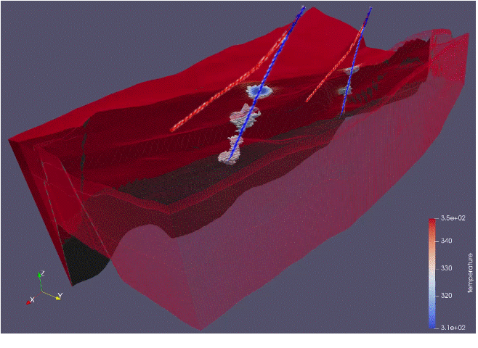
Why Numerical Methods?
Overcome Analytical Limitations: Handles complex geometries and real-world problems where analytical methods fail.
Improved Modeling: Approximate solutions often outperform oversimplified "exact" ones.
Flexibility: Supports parametric studies and diverse scenarios.
Simplify Complex Solutions: Reduces the effort of dealing with intimidating analytical formulas.
Enhanced Usability: Provides efficient computations and visually appealing outputs for interpretation.
DARTS - Delft Advanced Research Terra Simulator

Slide 20
Why NOT Numerical Methods?
Current numerical methods come with several limitations and challenges:
Computational Complexity: Solving PDEs numerically can be computationally demanding, particularly for large-scale and real-world problems.
Independent Computations: Each instance of the input space needs to be processed independently when using numerical methods (no interaction and mutual computations).
Exact Physics Knowledge: Numerical methods heavily rely on a precise understanding of the physics governing the problem.
Data Agnostic: Traditional numerical methods are not designed to leverage existing datasets for learning or data-driven approaches.

Slide 21
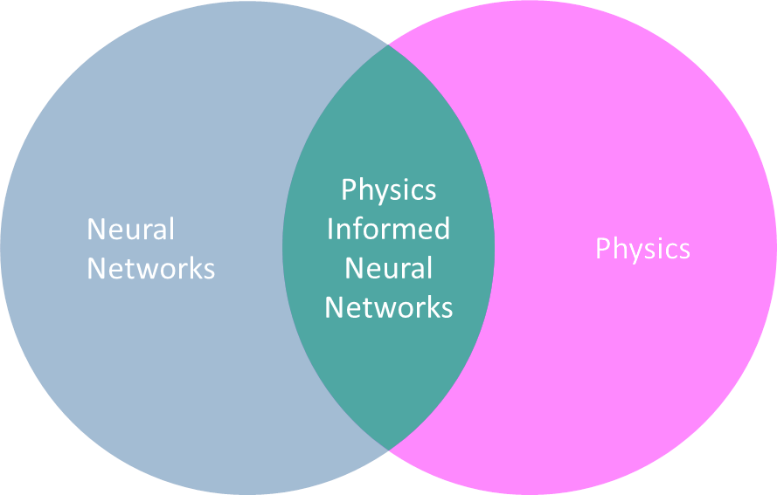
Incorporating Physics into Learning
Semi-supervised Learning
(Physics Informed Learning)
Enforce physical laws as hard/soft constraints
Supervised Learning
(Operator Learning)
Train on large amount of data and let the NN learn the physics based operators
Notes:
Scientific Machine Learning (SciML) refers to the integration of machine learning techniques with traditional scientific computing to improve the modeling, simulation, and understanding of physical, biological, and other natural phenomena. The goal is to combine data-driven approaches (such as neural networks and deep learning) with physical laws and equations (such as partial differential equations, or PDEs) to enhance both the accuracy and efficiency of predictive models.

Slide 22
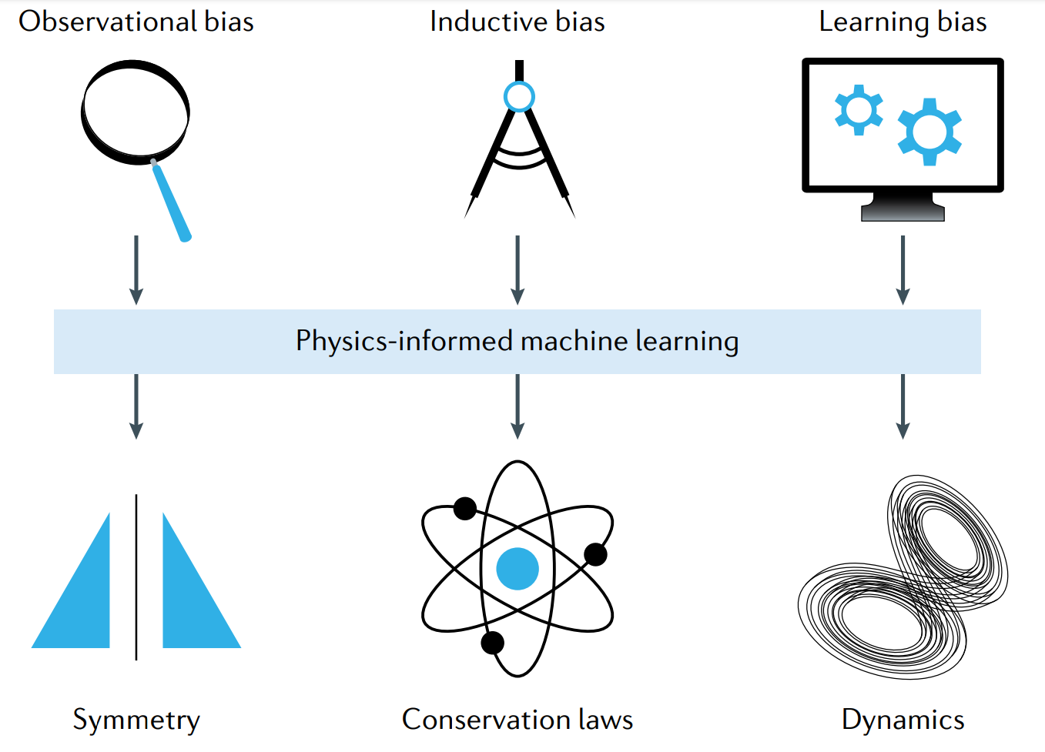
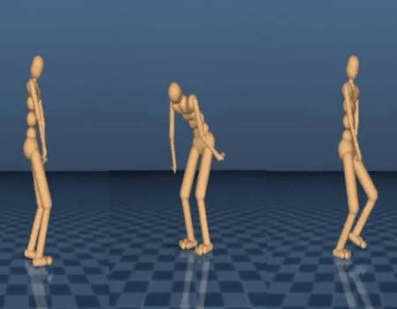
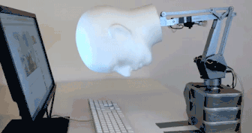
Physics Informed Machine Learning
> PINNs: Great for some PDEs, particularly with low complexity, and low training data. Have several negatives. We need alternatives
Karniadakis et al., 2021

Slide 23
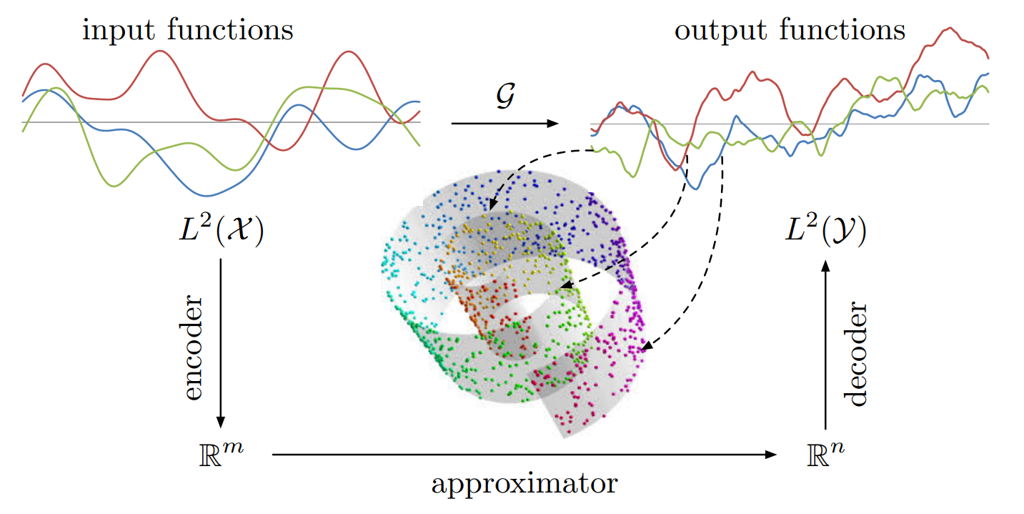
Operator Learning (Ψ : X → Y)
Goal: Learn Ψ from samples S: Supervised Deep Learning
> Train on large amount of data (and hope) that the NN learns the constraints
Task: Find a Surrogate (based on DNNs) from data.
Ψ
S
NOMAD: Nonlinear Manifold Decoders for Operator Learning
mapping from function spaces

Slide 24
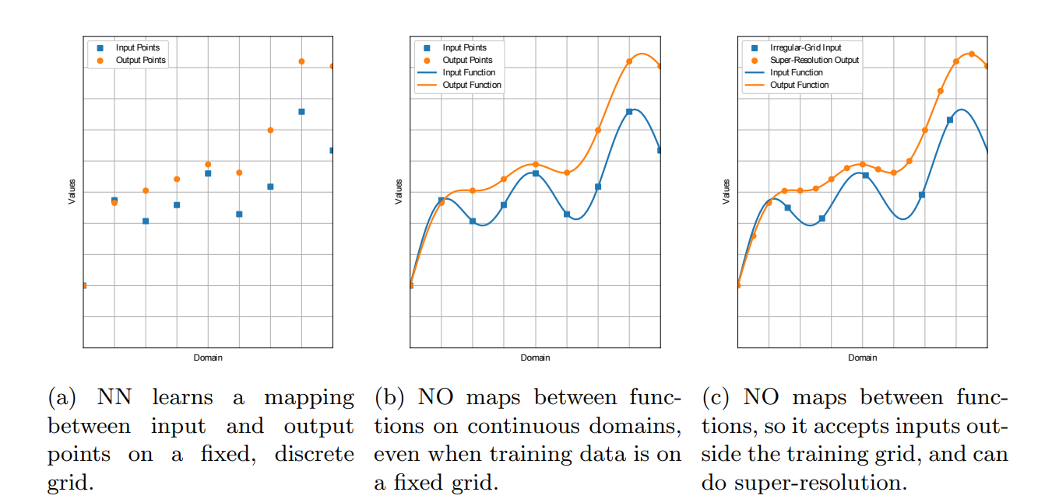
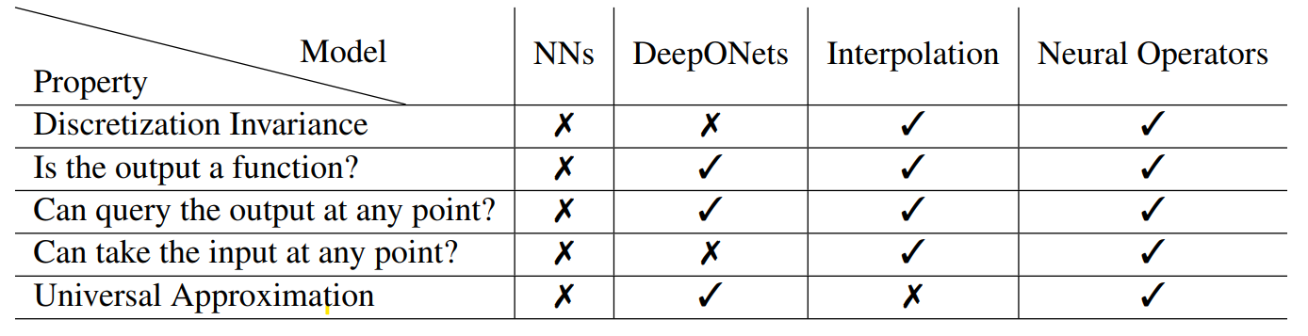
Operator Learning (Ψ : X → Y) Comparison of neural networks with neural operators
Azizzadenesheli, Kamyar, et al. "Neural operators for accelerating scientific simulations and design." Nature Reviews Physics (2024): 1-9.
Notes:
a, a neural network learns a mapping between input and output points on a fixed, discrete grid. b, A neural operator maps between functions on continuous domains, even when training data are on a fixed grid. c, Because a neural operator maps between functions, it accepts inputs outside the training grid and can do superresolution.
Table: Comparison of deep learning models. The first row indicates whether the model is discretization invariant. The second and third rows indicate whether the output and input are a functions. The fourth row indicates whether the model class is a universal approximator of operators. Neural Operators are discretization invariant deep learning methods that output functions and can approximate any operator.

Slide 25
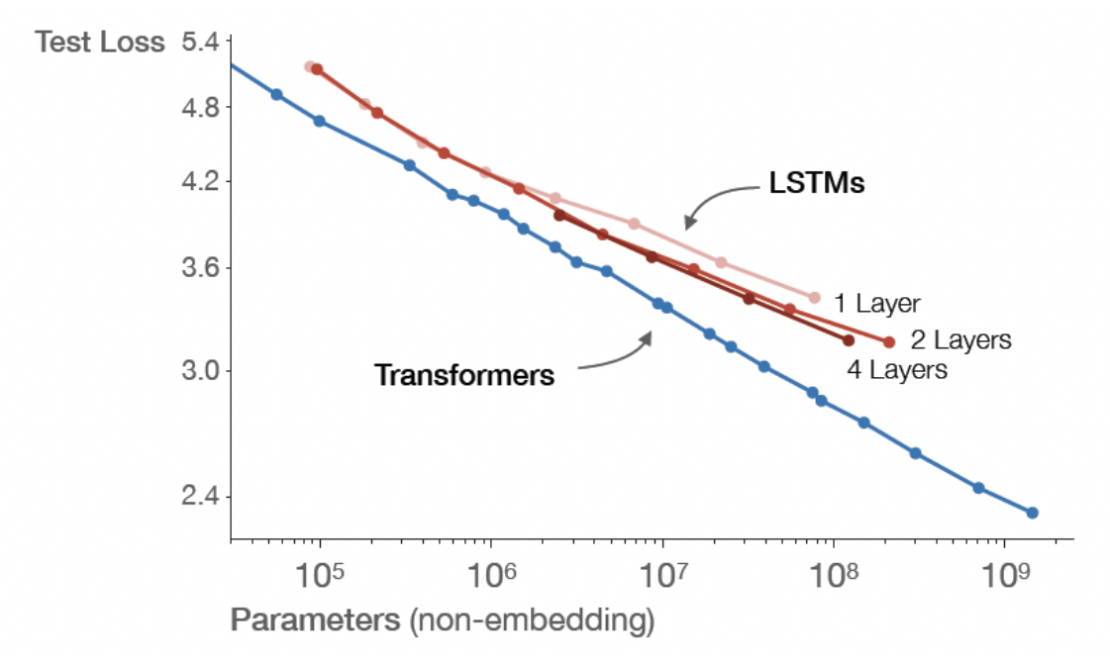
Operator Learning (Ψ : X → Y)
DeepONet
Fourier Neural Operator (FNO)
Convolutional Neural Operator (CNO)
Graph Neural Operator (GNO)
Operator U-Net architecture
GenCFD
…
https://neuraloperator.github.io/dev/index.html

Slide 26
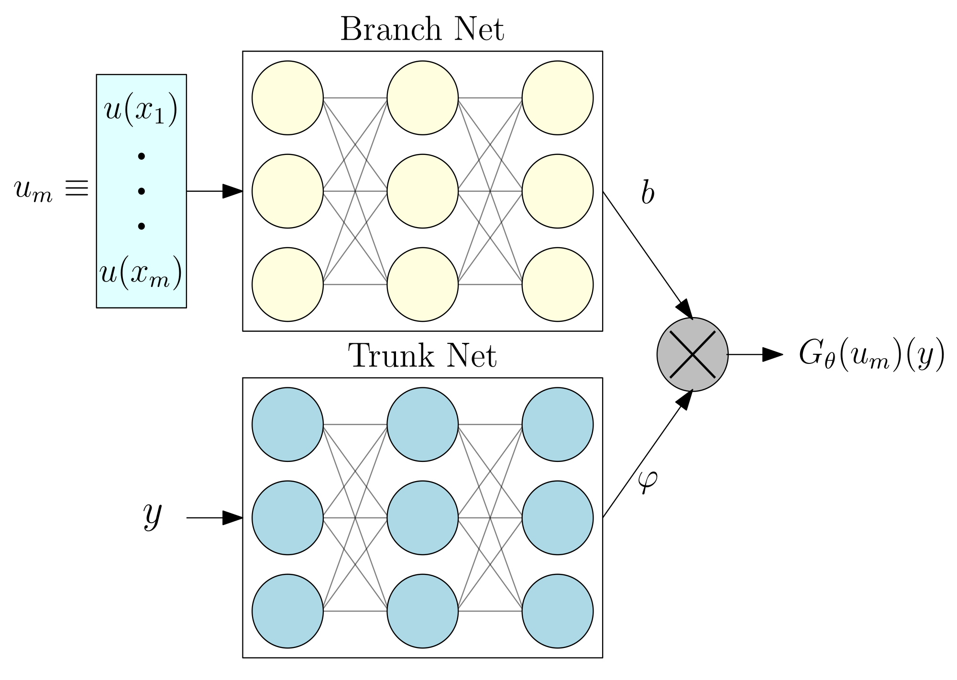
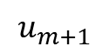
DeepONet (Deep Operator Network)
Branch Network: Processes the input function by evaluating it at a set of fixed sensor points. These evaluations are then transformed into a feature representation.
Trunk Network: Takes the coordinates where the output function is to be evaluated and generates corresponding basis functions.
$$u_{m+1}$$
https://www.mdpi.com/1999-4893/15/9/325
https://arxiv.org/abs/1910.03193

Slide 27
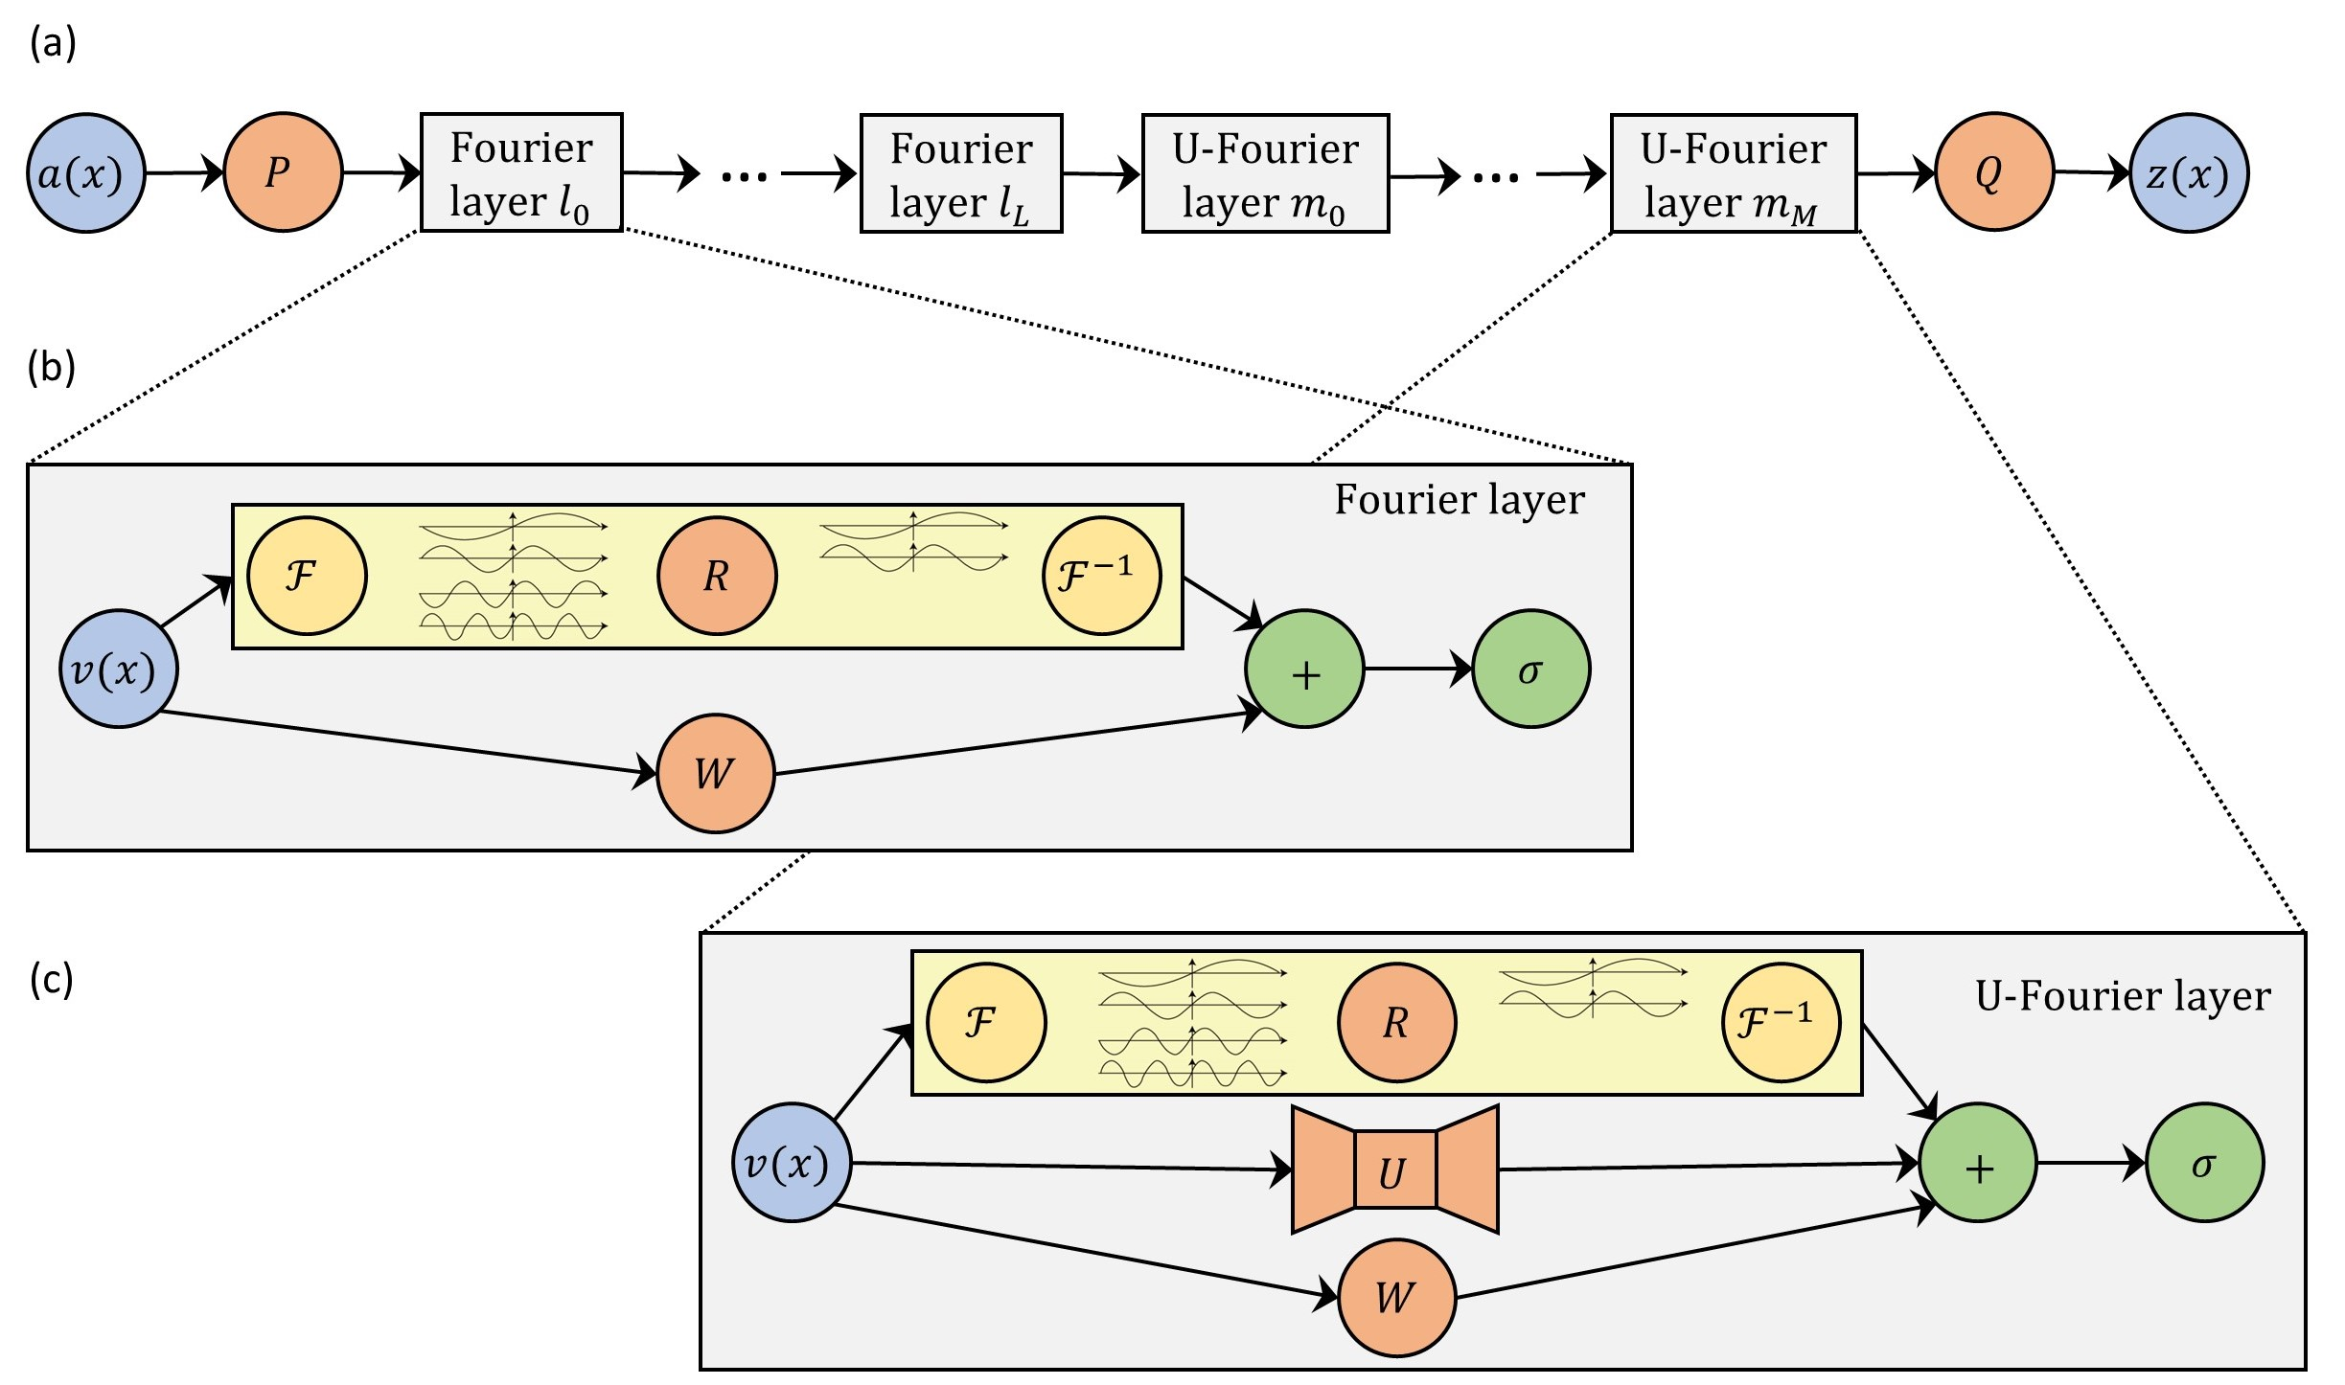


Fourier Neural Operator (FNO) (2020)
Architecture: A series of Fourier transforms, convolutional layers, and Fourier layers to model long-range dependencies and complex spatial patterns.
Parameter Count: Ranges from millions to tens of millions of parameters.
Application: Designed to handle high-dimensional PDEs, particularly those involving turbulence or nonlinear dynamics, like the Navier-Stokes equations.
Use Case: Applications in complex fluid dynamics and atmospheric modeling due to FNO’s ability to capture intricate spatial structures over larger domains.
https://arxiv.org/abs/2010.08895

Slide 28
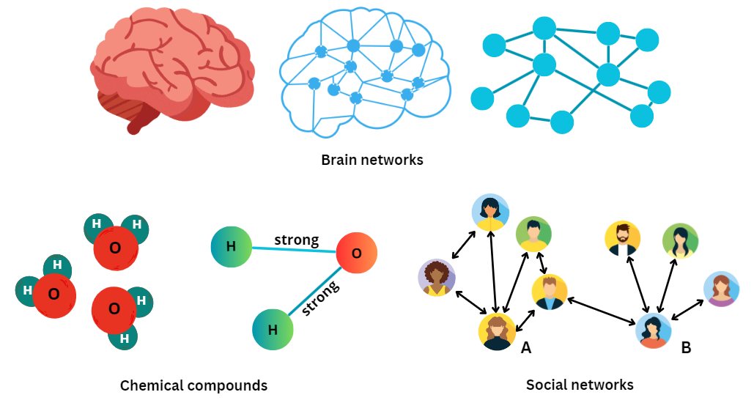
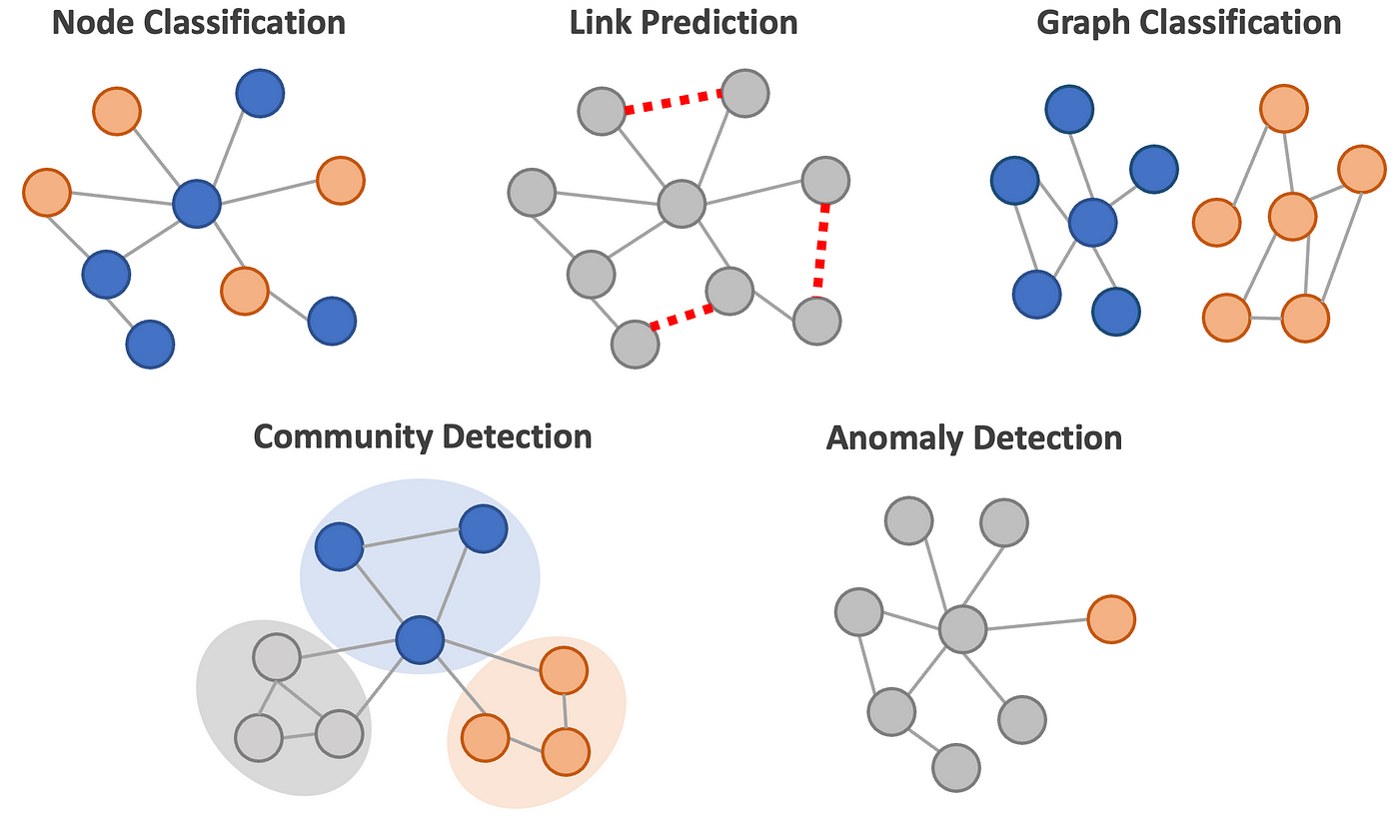
Graph Neural Networks
Graphs : Nodes + Edges
Interesting Possibilities
https://medium.com/@bscarleth.gtz/introduction-to-graph-neural-networks-an-illustrated-guide-c3f19da2ba39
A nice course: https://gnn.seas.upenn.edu/

Slide 29
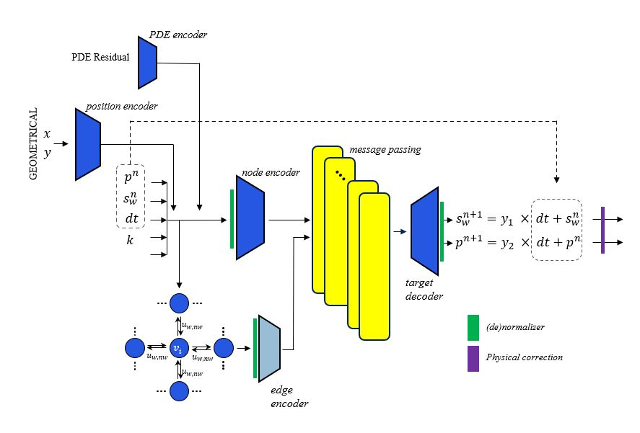
Graph Neural Networks

Slide 30

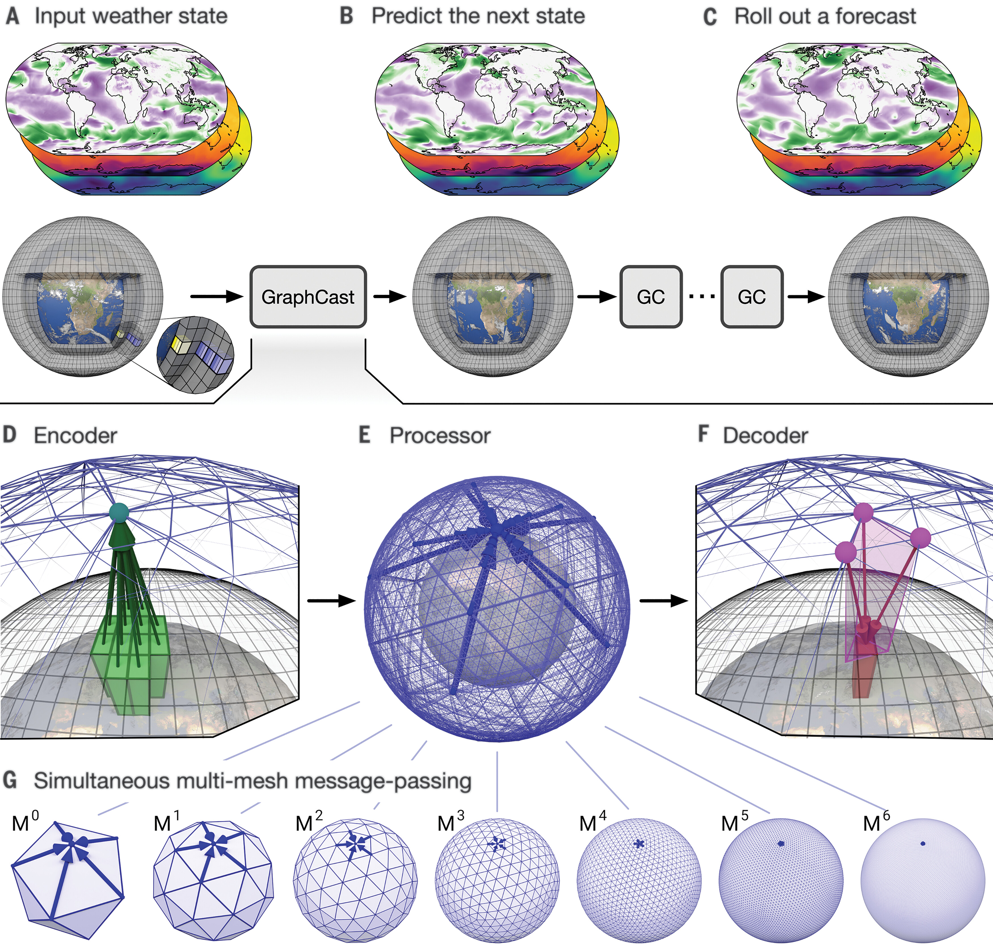
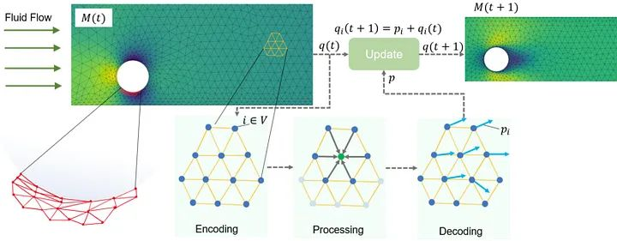
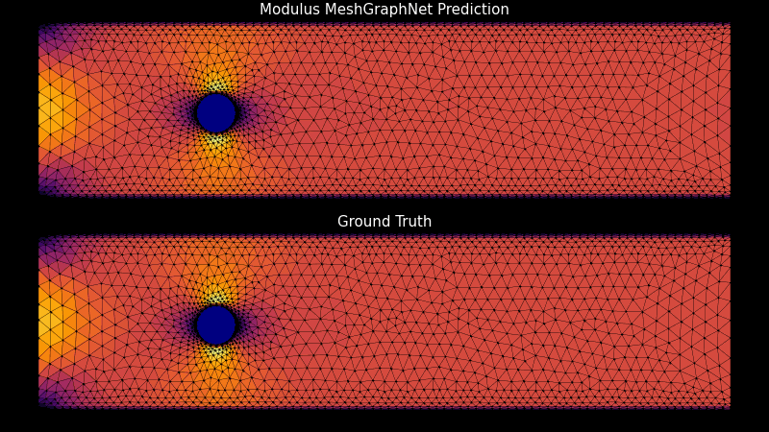
Graph Neural Networks
GraphCast
https://developer.nvidia.com/blog/develop-physics-informed-machine-learning-models-with-graph-neural-networks/
https://www.science.org/stoken/author-tokens/ST-1550/full

Slide 31
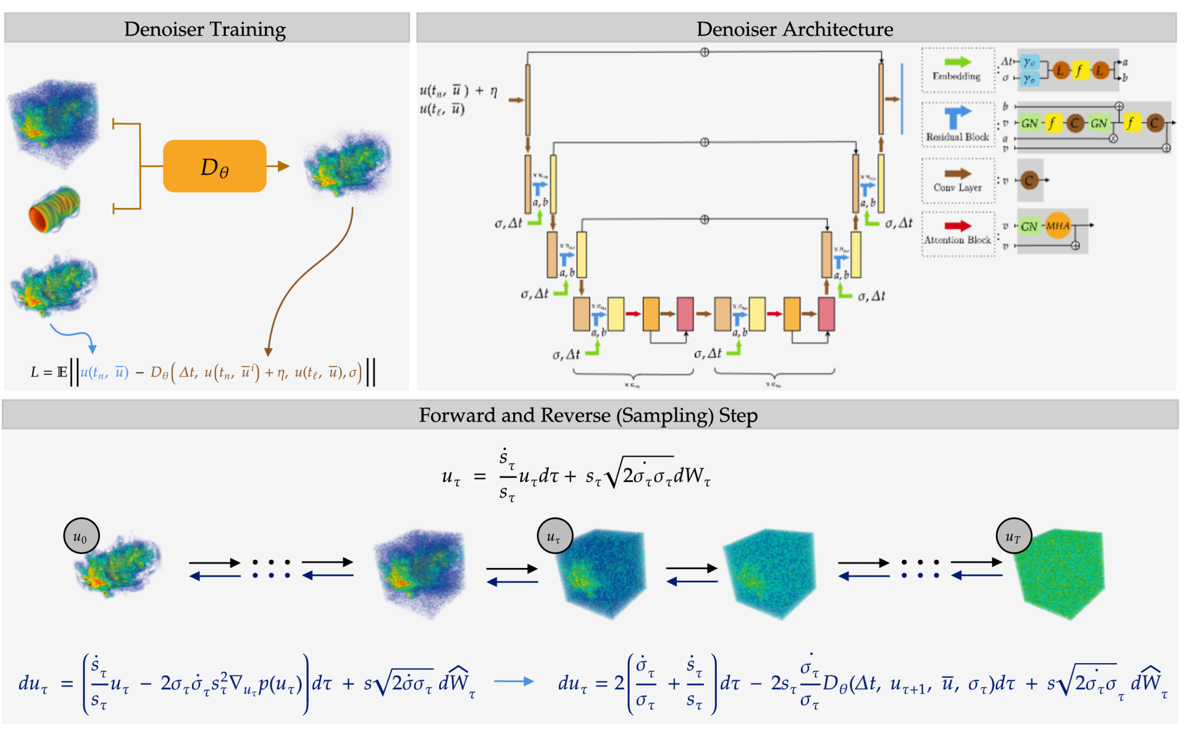
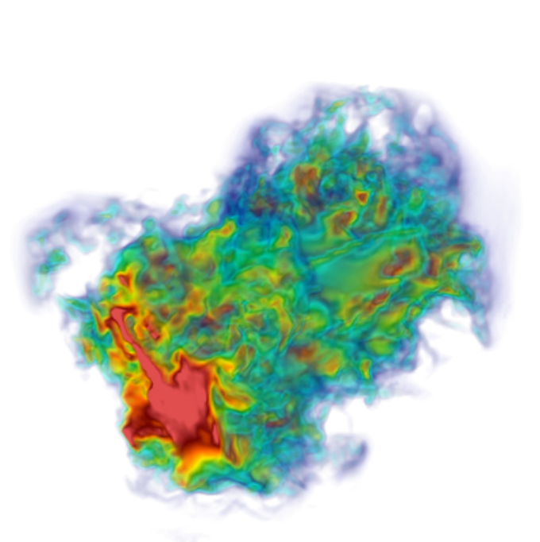
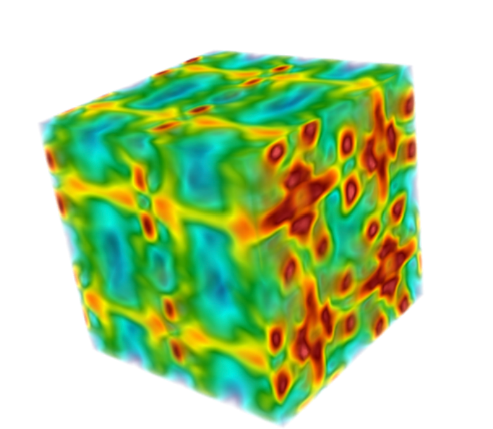
GenCFD Generative AI for Statistical Computation of Fluids
https://camlab.ethz.ch/
https://arxiv.org/pdf/2409.18359

Slide 32
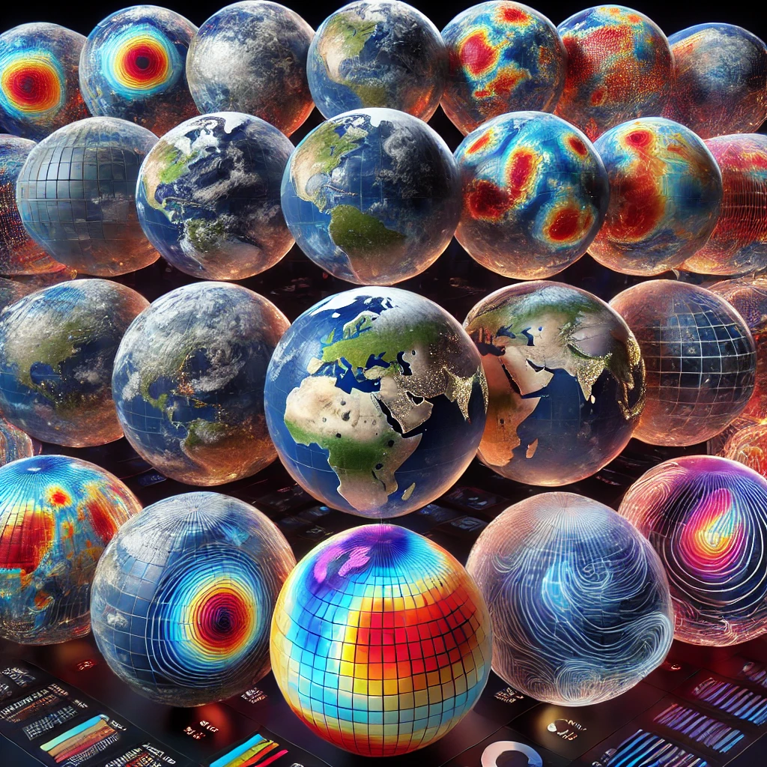
Limitations of Operators
They need lots of training data
Generalization to unseen domains
Computational cost of training
Limited Interpretability
Handling High-Dimensional Inputs and Outputs
Scalability to Complex Systems
They are still under development. A long way is ahead.

Slide 33

A short break ☺

Slide 34
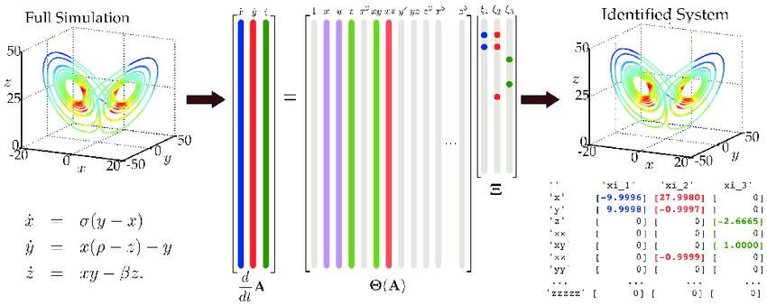
Sparse Identification of Nonlinear Dynamics (SINDy)
Purpose: SINDy identifies governing equations of a dynamical system directly from data.
Key Idea: It combines sparse regression techniques with a library of candidate functions to discover concise, interpretable models.
https://www.pnas.org/doi/10.1073/pnas.1517384113

Slide 35
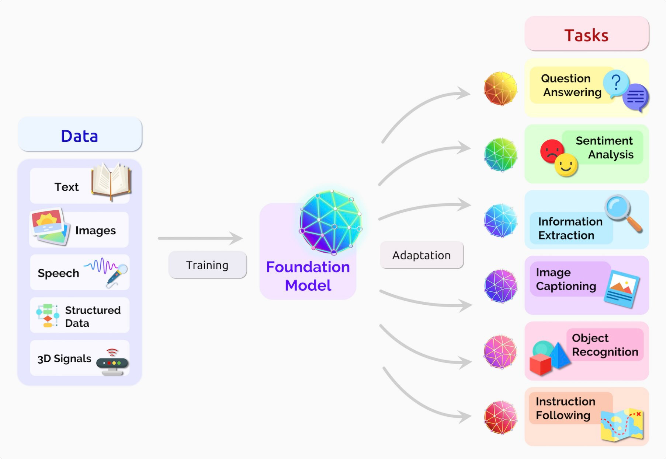




Foundation Models Multi-Operator Learning (MOL)
The Foundation Model: Key Facts and Insights | BasicAI's Blog

Slide 36
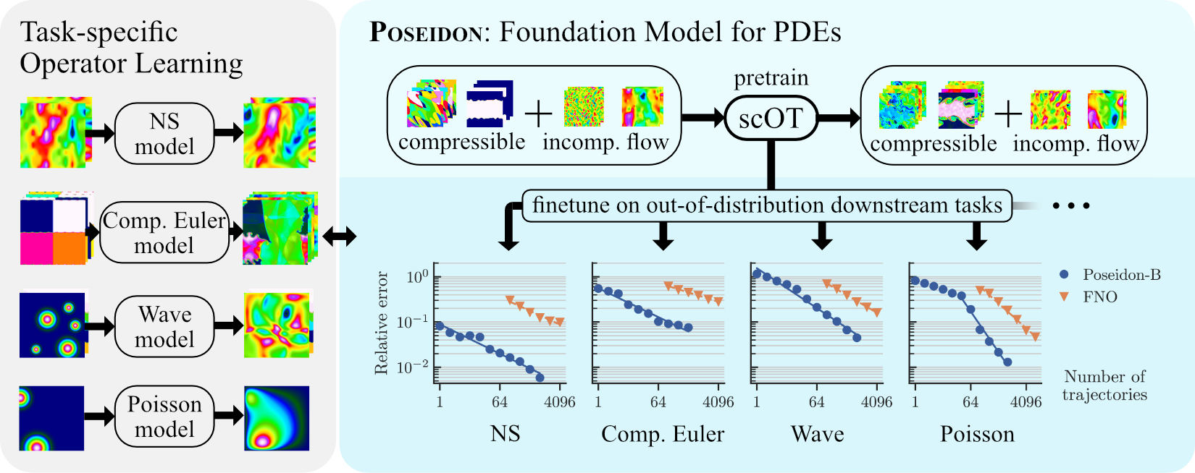
Foundation Models for PDEs Poseidon: Efficient Foundation Models for PDEs (2024)
🧜‍♂️
https://github.com/camlab-ethz/poseidon

Slide 37
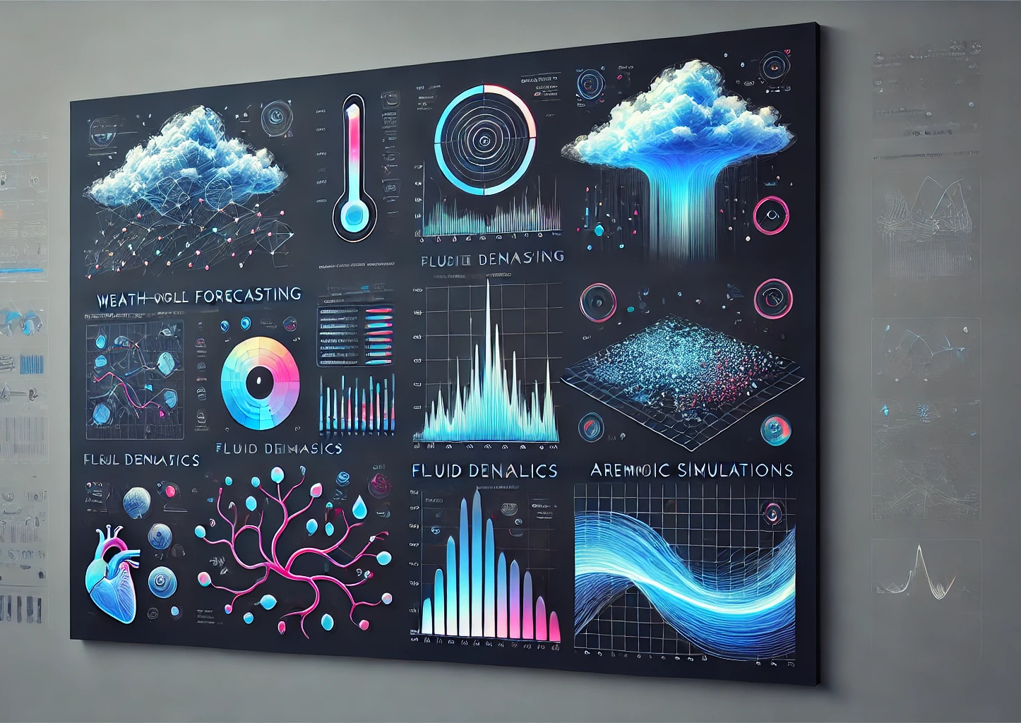
Examples of Real World Applications

Slide 38
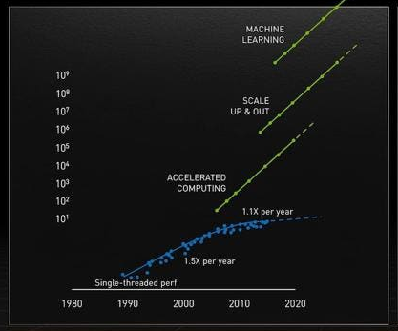
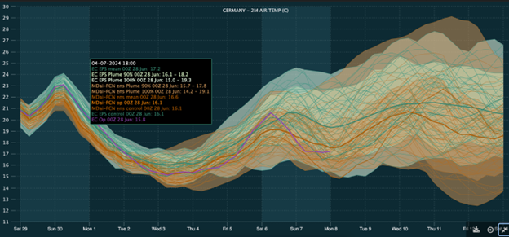
Caltech: Predicting Extreme Weather Predictions
FourCastNet: Fourier ForeCasting Neural Network
Notes:
https://developer.nvidia.com/blog/empowering-energy-trading-with-metdesk-and-nvidia-earth-2/

Slide 39
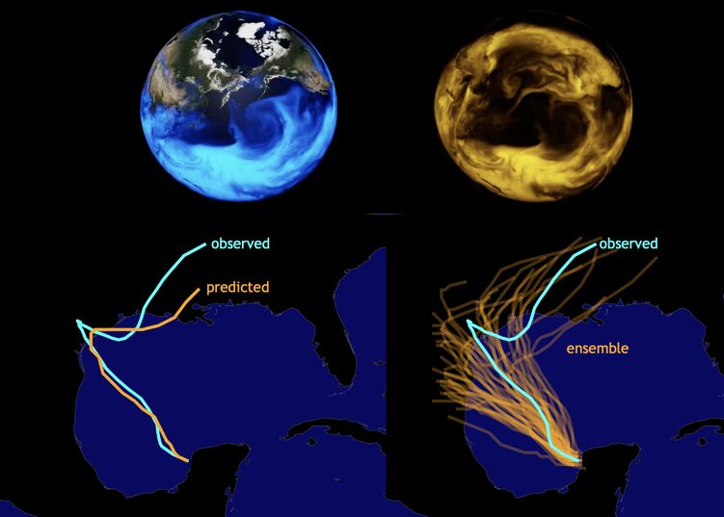

Caltech: Predicting Extreme Weather Predictions
The speedup allows weather predictions to be obtained in a matter of seconds vs. traditional weather models taking hours on a large CPU cluster (45,000 times faster).
What matters is not just a single run of a forecast but rather a large number of slightly different scenarios and seeing how the trajectories evolve over time.
In such cases, deterministic forecasts (the plot on the left) are just not sufficient.
Anima Anandkumar, FourCastNet

Slide 40

Progress of AI-weather models over time
https://docs.google.com/spreadsheets/d/1n30zDDjEzlXl5nAGF8uD_dbZWJAamqImQGCZjfOMuDg/edit?gid=0#gid=0
Author: Stephan Rasp (srasp@google.com)

Slide 41

Computational Costs
FourCastNet's training utilizes 3,072 A100 GPUs
40GB PCIe Version: ~ $7,400.
80GB PCIe Version: ~ $24,300.
Total: 23-76 M$
Training time is 67.4 minutes

Slide 42

Ansys SimAI vs. Fluent
Ansys #SimAI Prediction on new SUV geometry takes less than 1 min.
SimAI Drag error compared to CFD is less than 0.5% (5 to 10 drag counts) and accurate skin friction field and wake topology prediction.
https://jousef.substack.com/archive?sort=new
Notes:
https://www.linkedin.com/posts/jousefmurad_simai-engineeredmind-science-activity-7262724868960350209-3lCa?utm_source=share&utm_medium=member_desktop

Slide 43

NeuralDEM Real-time Simulation of Particulate Flows
NeuralDEM presents an end-to-end approach to replace Discrete Element Method (DEM) routines and coupled multiphysics simulations with deep learning surrogates.
DEM NeuralDEM
Mass flow
https://nx-ai.github.io/NeuralDEM/
Notes:
https://www.linkedin.com/posts/jousefmurad_simai-engineeredmind-science-activity-7262724868960350209-3lCa?utm_source=share&utm_medium=member_desktop

Slide 44

Then, what is PINNs?
Next Session ☺

Slide 45

Before that, We need a real break!

Slide 46
Thank You For Your Attention!
* Showing the loss-landscape during training a PINNs model!

